Slide 1
COVID-19 Vaccine Implementation Advisory Committee
November 20, 2020

Slide 2
Committee Purpose
Per CDC, jurisdictions must establish a Vaccine Implementation Committee to enhance development of plans, reach of activities, and risk/crisis response communication messaging and delivery.
Membership should include leadership from the jurisdiction’s COVID-19 planning and coordination, representatives from key COVID-19 vaccination providers for critical population groups identified by CDC, and representatives from other sectors within the community
The Vermont COVID-19 Vaccine Implementation Advisory Committee will serve an advisory role to the Commissioner of Health and assist with these four primary activities:
Identify and reach critical populations
Promote COVID-19 vaccination
Develop crisis and risk communication messaging
Carry out the Vaccine Implementation Plan

Slide 3
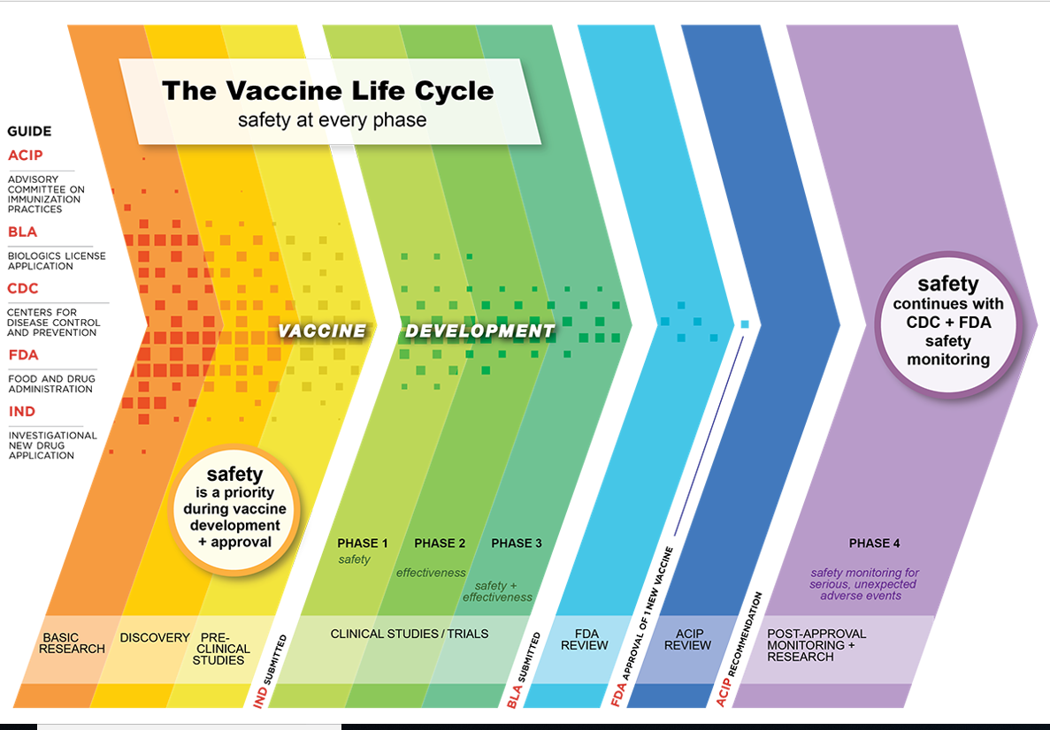

Slide 5
Plan Overview: Phased Approach
Phase 1: Potentially Limited Doses Available
Phase 2: Large Number of Doses Available, Supply Likely to Meet Demand
Phase 3: Likely Sufficient Supply, Slowing Demand
Phase 4: More Supply than Demand

Slide 7
COVID-19 Among Health Care Workers

Slide 8
Phase 1a Population

