Slide 2
Working Toward Health Equity in Vaccination Planning
1. Identify barriers and opportunities in vaccination acceptance and uptake
Compile data to inform specific vaccine access and communication and translation strategies
2. Ensure information gathered is effectively used by policy leads, HOC Section Chiefs, and the Vaccination Branch
Coordinate vaccine clinics to strategically address population/community-specific barriers and concerns related to accessing the COVID-19 vaccine (registration, location, messaging, case management, etc.)
3. Ensure information is shared back to communities in effort to validate concerns, build trust, and inform vaccination perceptions and acceptance.
Implement effective two-way communication strategies with priority communities
Notes:
Listening sessions:
Visit existing coalitions, such as the Multi-Lingual Taskforce, the Chronic Disease and Disability Advisory Group, the Racial Equity Taskforce, to seek recommendations and hear feedback about how the COVID-19 vaccine is viewed in the communities that they represent
Partner with OLH throughout this process to identify existing local groups to engage with, or engage through District Offices
Pay special attention to BIPOC populations (more broadly than solely New Americans)
Short survey - (direct service staff/community members via cultural liaisons ) - work with HS
Focus groups - in Somali-Bantu, Congolese, Nepali, Arabic-speaking and Burmese communities
Here are the questions we asked in the focus groups.
Exploring vaccines
When vaccines become available, would you be accessing vaccines?
Are there cultural beliefs/practices preventing you from having a vaccine?
What concerns do you have about vaccines?
Yesterday the vaccine team from UVMMC attended the Health Disparities Council to do a listening session and learn about concerns with vaccines and vaccine trials
Of note: compensate people for their time. Fund cultural liaison agencies to assist with this; stipend individual participants

Slide 5
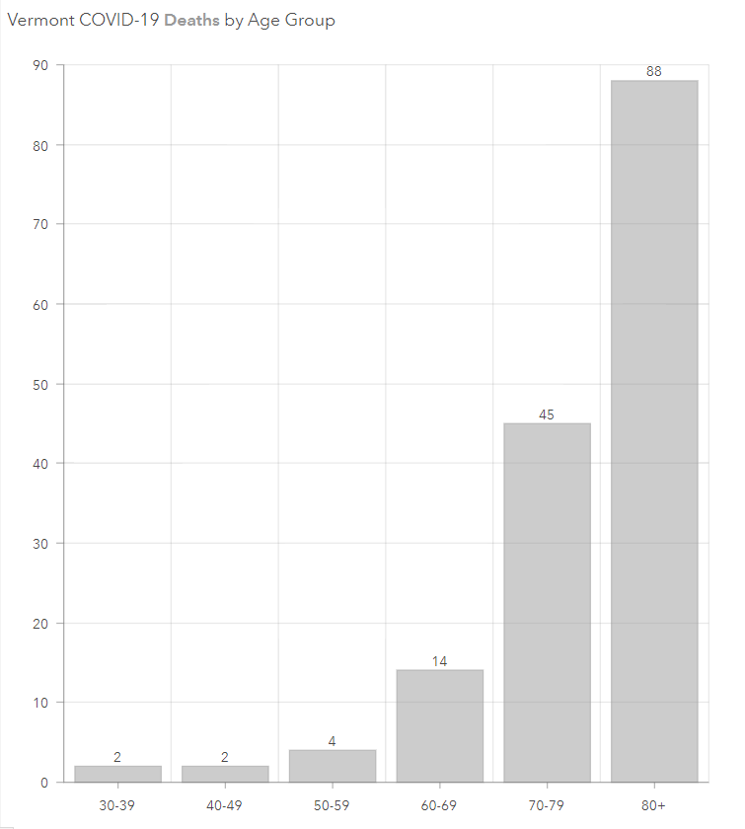
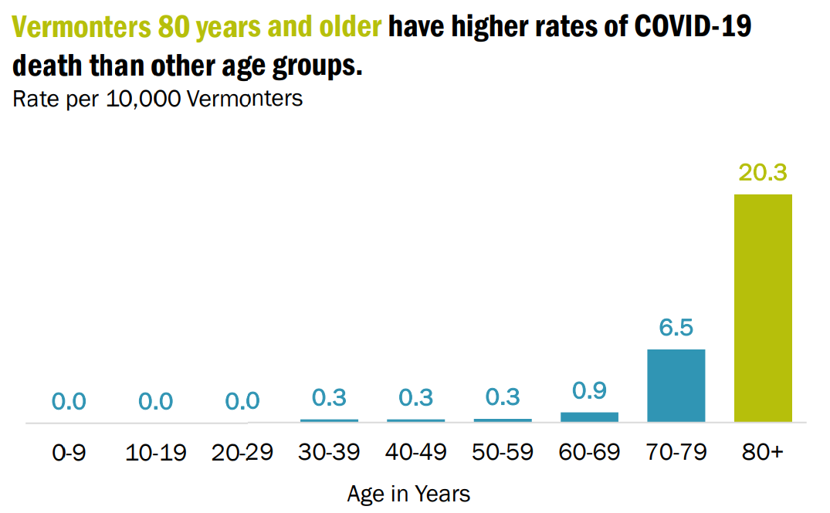
Death Rates Death Counts
From COVID Weekly Data Summary 12/18/20 Weekly Data Summary | Vermont Department of Health (healthvermont.gov)
From COVID Dashboard 1/8/21 9am VT COVID-19 Public Dashboard PRD v2.0 EB Container (arcgis.com)

Slide 6
220,148 (35%) of Vermonters are 55 Years or Older

Slide 9
Evidence for High-risk Conditions- CDC

Slide 10
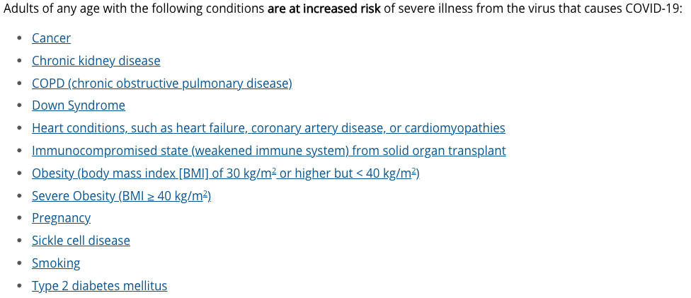
High-risk Conditions- CDC

Slide 11
Potential High-risk Conditions- CDC

Slide 12
Number of Vermonters aged 40-64 years with the following conditions:
 | # | %
COPD | 15,700 | 8%
Chronic Kidney Disease | 3,100 | 2%
Obesity | 48,800 | 26%
Severe Obesity | 9,000 | 5%
CVD | 14,500 | 7%
Smoking | 33,300 | 17%
Pregnancy* | 200 | 1%
Diabetes** | 18,000 | 9%
Cancer*** | 12,100 | 6%
1+ High-Risk Condition/Risk Factor (Including cancer)*** | 100,400 | 59%
1+ High-Risk Condition/Risk Factor (Excluding cancer)*** | 95,600 | 57%
Diabetes diagnosis, CVD diagnosis, Chronic Kidney diagnosis, and Cancer diagnosis are all EVER diagnosed.
CVD includes: myocardial infarction, coronary heart disease, and stroke.
Obesity indicates those with a BMI of 30 kg/m2 or higher but < 40 kg/m2.
**Diabetes measure does not distinguish between Type 1 and Type 2.
***CDC high-risk conditions and risk factors list refers to 'current cancer,' not 'ever'. As a result, the cancer information likely overestimates the population.
Down Syndrome, Immunocompromised, and Sickle Cell are not captured on the BRFSS. VHCURES data were analyzed for these populations: fewer than 200 Vermonters aged 40-64 had for down syndrome, sick cell disease, or had an immunocompromised state (weakened immune system) from solid organ transplant, which is likely an underestimate.
Data source: BRFSS (2019); VHCURS (2019)
*Only asked of women 18-49. The number indicates the average number per year from 2013-2019. These data are suppressed because the RSE was large.
Vermont Healthcare Claims Uniform Reporting and Evaluating System (VHCURES) through the Green Mountain Care Board. Analyses, conclusions, and recommendations are solely those of the Vermont Department of Health and are not necessarily those of the GMCB.

